Slide 1
Accreditation Information for Interested Parishes
Diocese of Green Bay
Education Department

Slide 2
Prayer
To the Spirit of Light and Love
"No eye has seen, nor ear heard, nor the heart of man conceived, what God has prepared for those who love Him, " God has revealed to us through the Spirit. For the Spirit searches everything, even the depths of God…Now we have received not the spirit of the world, but the Spirit which is from God, that we might understand the gifts bestowed on us by God. And we impart this in words not taught by human wisdom but taught by the Spirit…1 Corinthians 2:9-10,12-13
May the Holy Spirit the Spirit of Pentecost, help us to clarify what is ambiguous, to give warmth to what is indifferent, to enlighten what is obscure, to be before the world true and generous witnesses of Christ’s love, for no one can live without love.
COME HOLY SPIRIT, enlighten our minds and hearts as we discern this accreditation process with our parish. Amen

Slide 3
Why accreditation?
You are disciples who work for Christ in a professional capacity.
Disciples have goals. Professionals have goals.
Accreditation aims to focus our efforts on the goal of authentic evangelization and catechesis.
In order to evangelize and catechize effectively, there are certain best practices that characteristically define a faith-filled, fruitful faith formation program
The accreditation process standardizes these key elements in a faith formation program that best evangelizes and catechizes our youth and their families.

Slide 4
What are parishes measured by in accreditation?
The 12 standards are outlined in the accreditation packet
You can find the entire packet here at www.gbresources.org and click on Religious Education Administrators

Slide 5
Who works on this from a parish level?
The RE administrator
A team that is put together by the RE administrator that includes people willing to help with the planning and collaboration (catechists, volunteers, parents)
Pastor/pastoral leader
Finance council and parish council are notified and extended an invitation to participate

Slide 6
Who does the accrediting?
The diocese has developed the standards that visiting teams use to evaluate programs
The visiting team is made up of 3-6 people from around the diocese who have been or are currently involved in religious education or an educational program and are asked to compare the program to the standards
These individuals are past or current DRE’s, CRE’s, past principals, parents involved in a religious education program outside of your parish program, or diocesan representatives
The team members are chosen to be objective
The final accrediting body is the Diocesan Department of Education noting the recommendation from the visiting team.

Slide 7
How is the information gathered to know the standards are being met?
The information is gathered through observations, written material submitted by the parish committee or DRE, and interviews of the pastor/pastoral leader, catechists, parents, and students.
Anyone who is interviewed is hand picked by the parish (not selected at random).
All information is recorded by the visiting team to show evidence that the standard is being met.

Slide 8
How long does it take?
The process begins with a letter formally submitted to the Diocesan Department of Education (template of the letter online)
The religious education administrator than takes the year and sets up a team to help him/her with the preparations.
A year from the letter’s submission, the visiting team will visit the parish.
There will be at least 2 nights of observations on the religious education nights.
There will be a final meeting with the religious education administrator, the pastor/pastoral leader, and the visiting team on the findings and recommendations

Slide 9
What do the observation nights look like?
First, depending on the size of your parish program, the team might come 2 times or it might come 3-4 times.
The team wants to devote adequate time to the task at hand and see all that your parish has to offer!
The observation nights are chosen by the parish and given to the visiting team – consecutive weeks are preferred.
If different classes meet at various times and days, the team would make sure to visit all of the grade levels.

Slide 10
What do the observation nights look like (cont.) Here is a sample, but times vary depending on class times:
Night One (Wed) Grades 1-8 | Night Two (Sun) Grades 9-11 | Night Three (Following Wed) Grades 1-8
1pm Visiting team arrives at parish, gets tour, visiting team has place to put their own materials, interview with pastor or pastoral leader | 4pm Interviews of 1-2 parents in program (DRE/CRE hand picks and invites) | 3pm-5pm Visiting Team meets and conducts interviews of parents, catechists
3pm Interview DRE/CRE | 5pm-7pm Observe high school classes | 5pm-7:30pm Observe classes
4pm Visiting Team takes time to establish plan; DRE prepares for the night | 7pm Interview 1-2 teens (DRE/CRE hand picks and invites) | 7:30pm Visiting Team has interviews with a few catechists
5pm Classes begin, visiting team observes classes and conducts interviews of parents/students (DRE/CRE hand picks and invites) |  | 8pm Visiting team collaborates before leaving at 8:30pm

Slide 11
How do we know if we passed?
The visiting team meets alone with one another after the observations nights have concluded. They talk through, combine, and condense the information gathered into a usable format.
The information is then presented to the pastor/pastoral leader and DRE/CRE. More people can be invited by parish leadership if they so choose.
The visiting team then presents its findings and reveals what they are recommending to the diocesan department of education (accreditation, accreditation with stipulations, or no accreditation)
The Department of Education will then contact the parish within 2 weeks with it’s final decision based on the evidence submitted by the visiting team

Slide 12
What are the benefits of being accredited?
You know what kind of job you are doing
You know how to improve your program
A pastor or pastoral leader has a better handle on how effective their program is
We can begin highlighting what parishes are doing well and how individual parishes can help others around the diocese
The program develops a professionalism about it
The process allows for families, catechists, and parishioners to be engaged in improving the program and allows them to see the good that is under their own parish roof!

Slide 13
We already know what you are thinking…

Slide 14
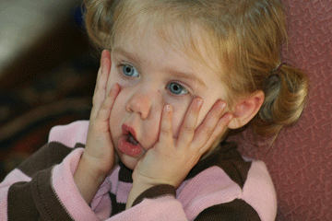

Slide 15
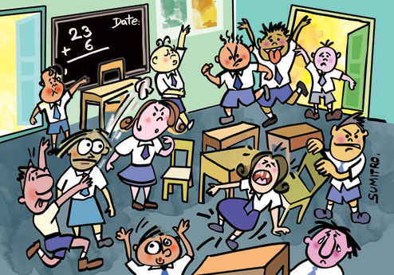
But my program is far from perfect…
All programs are. They are human.
We expect imperfect programs.
But God is perfect and can do great things beyond our imagining each night students gather to encounter Christ.
Don’t be afraid to offer God your program. It was his ever before it was yours.

Slide 16
I know I already don’t meet some of the standards.
That’s ok. Standards are goals.
To be accredited, you don’t have to meet exactly every standard with flying colors.
Heaven is our goal, but we aren’t there yet. We are always works in progress.
So too, our programs are works in progress. That’s not an excuse or cop out, but a reality.
Each week, our faith formation programs should be more and more conformed to Christ. That’s what accreditation is all about. Is there progress, growth, and openness to the Holy Spirit to improve the program? And if so, is the faith formation program constantly improving?

Slide 17
Remember…
Your program is not being criticized.
Accreditation is to improve, not to demean or to condemn.
We are here to help and support.
Remember that we all work together to bring students to Christ. It’s a tough job, but together, we can do it with God’s guidance.
Don’t be afraid of this process. It will be refreshing to see how many things you are already doing!

Slide 18
To receive more information…
Visit our website at www.gbresources.org
Email Maria Schuette at mschuette@gbdioc.org or Sr. Jacqueline Spaniola at jspaniola@gbdioc.org
We are happy to help!

Slide 19
Resources
Slide 2: - Prayer taken from Pope John Paul II - L’Osservatore Romano, 6-16-80]

