Slide 1
Beloved
Teenagers and Eating Disorders
Sarah Gavin

Slide 2
What is an eating disorder?
Serious but treatable illnesses with medical and psychiatric aspects.
Anorexia, bulimia, and bing eating disorder (BED) –diagnosable
“Other specified feed or eating disorder (OSFED).
Eating disorders often coexist with a mental illness such as depression, anxiety, or obsessive-compulsive disorder.
Obsession with food, body image, and weight.
Very serious, chronic, and can be life-threatening

Slide 3
Who gets eating disorders?
Females AND Males
As young as elementary school
Being diagnosed in their 30s, 40s, and older
All socioeconomic classes
Stats
Up to 30 million people of all ages and genders suffer from an eating disorder
Highest mortality rate of any mental illness
95% are between the ages of 12 and 25

Slide 4
Anorexia Nervosa
A disorder in which an individual refuses to maintain minimally normal body weight, intensely fears gaining weight, and exhibits a significant disturbance in his/her perception of the shape or size of his/her body.
15% below ideal body weight
Heart failure (caused by slow heart rate, low blood pressure; the use of drugs to stimulate vomiting, bowel movements, or urination; or starvation, which can also lead to brain damage)
Brittle hair and nails; dry skin, soft hair (lanugo)
Mild anemia
Swollen joins
Reduced muscle mass
Long-term constipation
Osteoporosis

Slide 5
Bulimia Nervosa
A person binges on food an average of twice weekly in a three-month period, followed by compensatory behavior aimed at preventing weight gain. This behavior may include excessive exercise, vomiting, or misuse of laxatives, diuretics, other medications, and enemas.
Erosion of tooth enamel
Inflammation of the esophagus
Enlarged glands near the cheeks
Stomach damage
Irregular heartbeat
Heart failure
Electrolyte imbalances (can lead to sudden death)
Peptic ulcers
Pancreatitis
Long-term constipation

Slide 6
Binge Eating Disorder
Consuming an amount of food that is considered much larger than the amount that most individuals would eat under similar circumstances within a discrete period of time.
High blood pressure
High cholesterol
Fatigue
Joint pain
Type II diabetes
Gallbladder disease
Heart disease

Slide 7
Signs and symptoms-emotional
Changes in attitude
Expresses body image complaints
Constantly comparing self of others
Incessant talk about food, weight, shape, cooking, exercise
Obsessive thinking about food—labels food good vs bad
Inflexible about diet without reason
Appears sad/depressed/anxious/ashamed/embarrassed
Emotions are flat or absent
Intolerance for imperfections in academics, eating, social life etc.
Target of weight bullying
Spends a lot of time at home
Reluctant to ask for help
Unwilling or unable to acknowledge recent changes

Slide 8
Signs and symptoms-physical
Sudden weight loss, gain, or fluctuation in short tim
Complaints of abdominal pain
Feeling full or “bloated”
Feeling faint, cold, or tired
Dark circles under the eyes or bloodshot eyes/burst capillaries around eyes
Calluses on the knuckles
Dry hair or skin, dehydration, blue hands/feet
Lanugo hair (fine body hair)
Fainting or dizziness upon standing; frequent fatigue
Thinning, dry hair

Slide 9
Signs and symptoms-behavioral
Diets or chaotic food intake; pretends to eat, then throws food away; skips meals
Creates rigid dietary rules
Exercises for long periods-obsessional attitude
Constantly talking about food
Difficultly sitting still
Makes frequent trips to the bathroom
Makes lists of food and calories eaten
Wears bagging clothing
Avoids cafeteria, works through lunch, eats alone
Shows some type of compulsive behavior (hand washing; hoarding)
Denies difficulty with food or body image

Slide 10
Common myths…
EDs are just a teenage girl problem
They will grow out of it
Purging only involves self-induced vomiting
As soon as they gain weight, they will be just fine
Too young
EDs are a choice. Snap out of it!
Everyone has an ED these days!
It’s just an ED, that can’t be a big deal. Eat a sandwich!
Anorexia is the only serious ED
If they say they are fine, I should believe them
Disordered eating is a dieting fad. NBD
As long as someone isn’t emaciated, they aren’t that sick
EDs are all about food

Slide 11
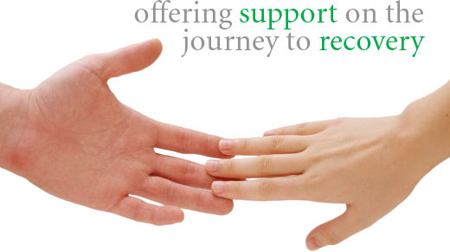
What can we do?

Slide 12
How YOU can help!
Have a relationship with parents
Educate yourself
Watch what you say about your self-image
You are NOT their savior….or their psychiatrist
Take their pain to the Cross
Follow through with relationship after they share their struggle
Have nights/class about Eating Disorders
Talk to their friends about it-educate and support them

