Slide 1
How Do We Know God Exists?
St. Thomas Aquinas’ 5 Proofs of God
Ms. DeMeuse | Introduction to Catholicism
Notes:
Through our human reason, we can know God with certainty (31-36,44-47)

Slide 2
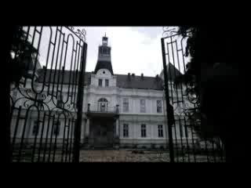

Slide 3
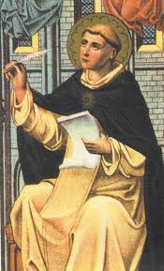
St. Thomas Aquinas
Born in 1225
Joined a religious order called the Dominicans
Wrote the Summa Theologiae
Shows how we can prove God exists through our reason
Notes:
There are rational arguments for the existence of God –not just because the Bible tells us so or that my priest tells me so. We use our reason in order to understand God.
Although we use material thoughts, God is removed from our earthly existence. God is distinct.

Slide 4
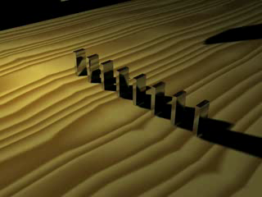
First Mover
Anything in motion is moved by another
God is the unmoved mover
Notes:
This is taken from Aristotle.
Everything in motion is caused by something else.

Slide 5
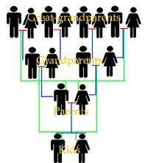
First Cause
Everything is caused by something else
If a rabbit appeared on your dinner table, would you say, “Hello rabbit!” No, you would look for how it got there
Things do not come into existence without a reason

Slide 6
Necessary Being
There are things that come in and out of being
EXAMPLE: A raccoon is born and dies. A rose grows and dies. A goldfish is born and dies. A person is born and dies.
We didn’t come out of nothing.
We did not come from chance.
God was never born. God is a necessary being for the rest to exist.
Notes:
Everything is dependent on something else.

Slide 7
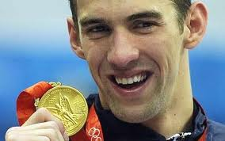
Greatest Being
If something is great, we compare its greatness to the greatest thing possible
Someone has to be ultimate goodness
Notes:
We compare goodness to something even greater than that.
The greatest thing we can think of is God.

Slide 8
Intelligent Designer
We act for an end
We have a purpose
Everything is meaningless if we are not designed for some one or some thing
God is the designer
Notes:
Saw cuts down a tree. Hammer is to nail something in a wall. We give these tools this purpose.
Our purpose as humans is to love. Who gives us this purpose? God

Slide 9
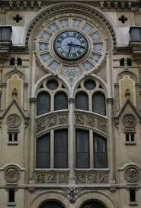
We see a clock, but we know there is a clockmaker who put it together.
It did not make itself.
There is someone more intelligent than the clock who designed it

Slide 10
How does one go about believing?
There is a sense of more beyond just the visual world
A person feels touched by a mystery and traces that point to the existence of God
There is a confidence in order to speak to God
A personal union with God is then developed
Believing is then accepting Jesus and staking one’s whole life to him
Notes:
CCC 150-152

